Slide 1
Tire quality classification using convolutional neural networks

Slide 2
PROBLEM DESCRIPTION

Slide 3
Motor vehicles and tires
Some Facts and Statistics
Motor vehicles are the most common form of transportation in North America
eight out of ten commuters travel by car, truck, or van to work, either as a driver or passenger.
By May 2023, cars accounted for 82.6% of Canadian commuters’ main method of transportation for going work (13.2 million people)
Faulty tires can result in less vehicle control and grip for the driver and in worst cases an uncontrollable tire blowout that can results in a crash

Slide 4

PROJECT DESCRIPTION

Slide 5
PROJECT DESCRIPTION
Transfer Learning
ResNet
This project will leverage the advantages of transfer learning on a known model, allowing for a great accuracy model that can be finetuned to the task at hand:
Preventive Maintenance
Quality Control
ResNet is a test and proven network architecture that allows for the training of deeper and more accurate models by incorporating shortcut connections:
Trained on ImageNet (pretrained on car wheels in class 479 of the dataset)
Low and High complexity versions (ResNet18 to ResNet152)
This project will use ResNet34 and ResNet152

Slide 6
methodology

Slide 7
DATA LOADING
Dataset
Data loading procedure
The dataset was obtained from Kaggle and contains 1854 tire images in various formats and sizes
Defective tires (1028 images)
Good tires (828 images)
After downloading the dataset the following steps where applied:
Dataframe creation with file name, file path, class name and label indexing (defective: 0, good: 1)
Conversion to custom DataSet object from pytorch (no transform applied)
Application of ResNet expected transforms

Slide 8
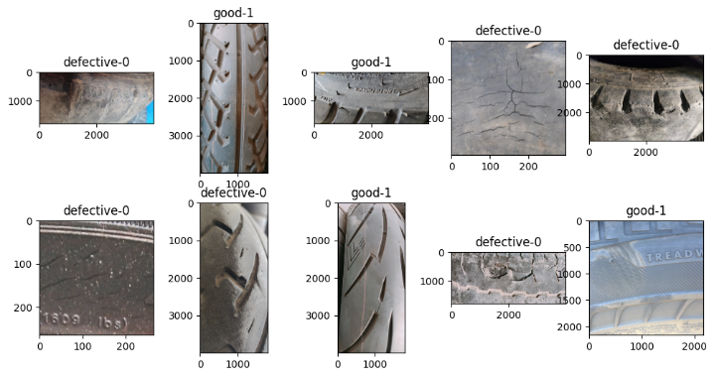
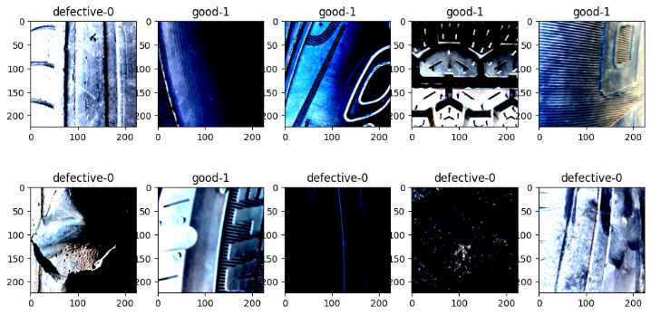
DATA EXPLORATION
The images had the ResNet transform applied, converting the images to PIL images, resizing to square images of 256 pixels, cropping from the center to 224 pixels and finally converting to tensors to apply the expected normalization for ResNet networks.

Slide 9
MODEL AND HYPERPARAMETERS
HYPERPARAMETER | VALUE
Batch size | 64
Learning rate | 0.001
Epochs | 10
Data split | 70%, 10%, 20%
Both ResNet34 and ResNet152 were tested, the last layer of the models was substituted for a dense layer of 2 neurons (2 expected classes), no activation function was used, therefore Cross Entropy was used as the loss function, and Adam as the optimizer.

Slide 10
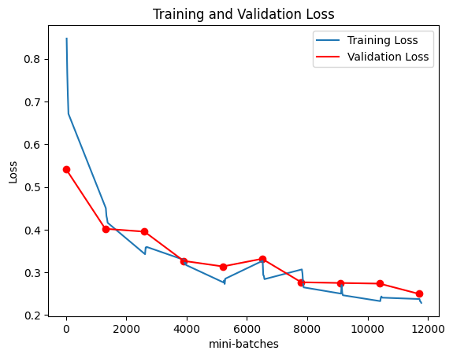
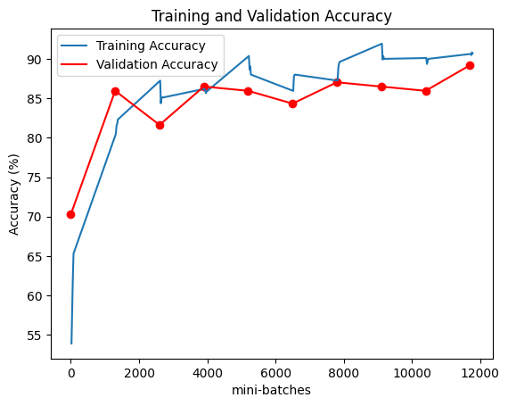
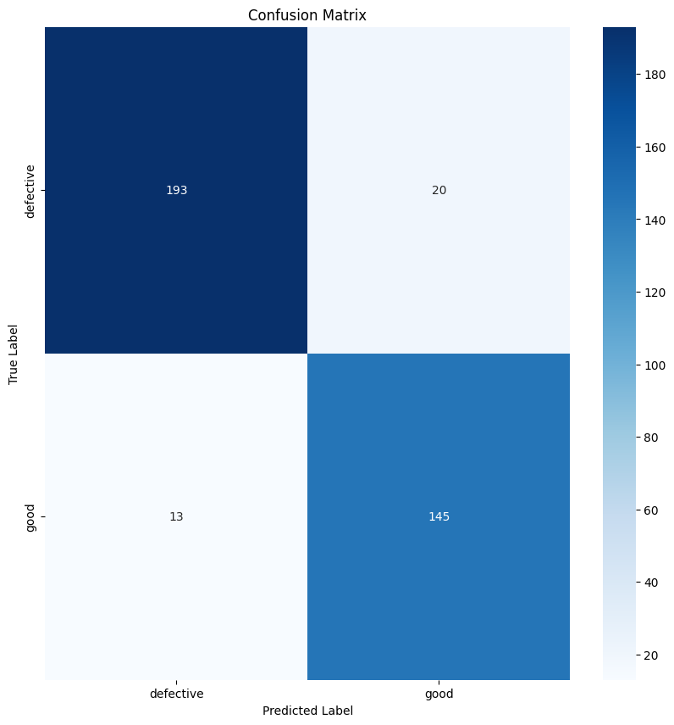
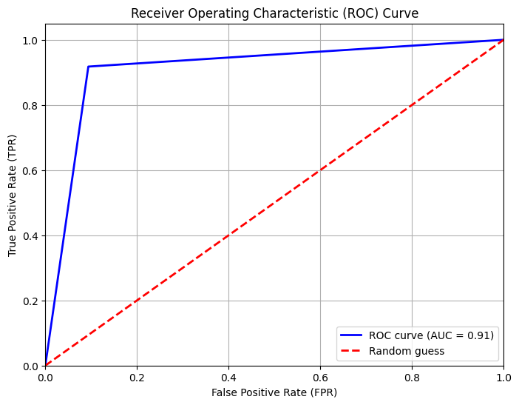
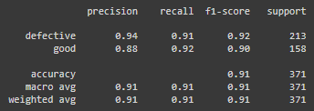
MODEL RESULTS: rESNET34
Important results
89.19% accuracy and 0.229 loss on las validation epoch
Overall accuracy of 91%
Similar metrics between both classes
Precision metric differed by 6 points (class imbalance)

Slide 11
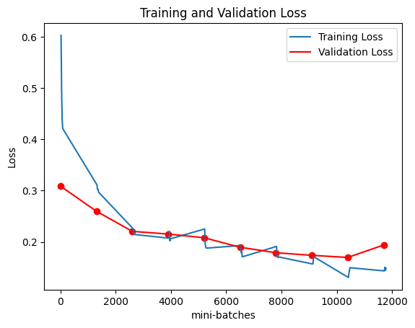
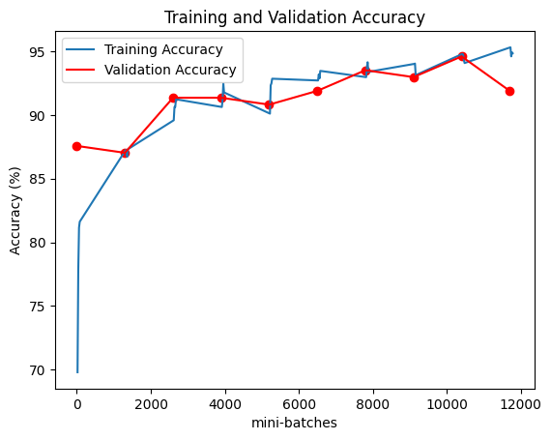
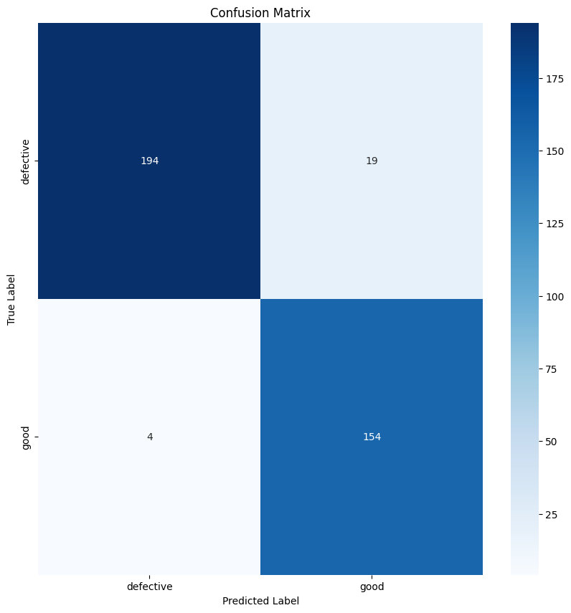
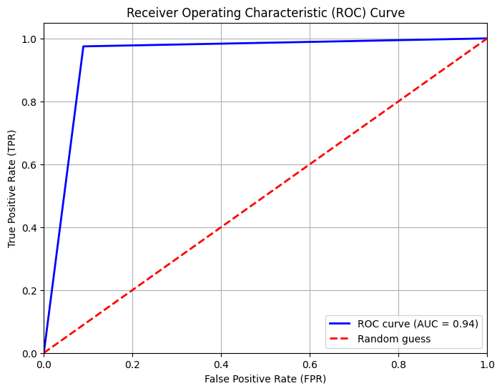
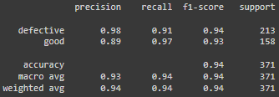
MODEL RESULTS: RESNET152
Continue improving
91.89% accuracy and 0.1939 loss on last validation epoch
Overall accuracy of 94%
Similar metrics between both classes
Precision metric difference between classes increased (98% defective vs 89% good)

Slide 12
CONCLUSIONS
Excellent performance on ResNet architechture
Simpler version of the network gave good results
More finetuning on simpler networks could give similar results to higher complexity versions
Smaller network with similar performance could provide advantages

Slide 13
THANK YOU
Fausto Enrique Guerrero Burguete
1227573

